Slide 1
3
APPLICATIONS OF
DIFFERENTIATION

Slide 2
3.6
Newton’s Method

Slide 3
INTRODUCTION
Suppose that a car dealer offers to sell you a car for $18,000 or for payments of $375 per month for five years.
You would like to know what monthly interest rate the dealer is, in effect, charging you.
To find the answer, you have to solve the equation 48x(1 + x)⁶⁰ – (1 + x)⁶⁰ + 1 = 0
How would you solve such an equation?

Slide 4
HIGH-DEGREE POLYNOMIALS
For a quadratic equation ax² + bx + c = 0, there is a well-known formula for the roots.
For third- and fourth-degree equations, there are also formulas for the roots.
However, they are extremely complicated.
If f is a polynomial of degree 5 or higher, there is no such formula.

Slide 5
TRANSCENDENTAL EQUATIONS
Likewise, there is no formula that will enable us to find the exact roots of a transcendental equation such as
cos x = x.

Slide 6
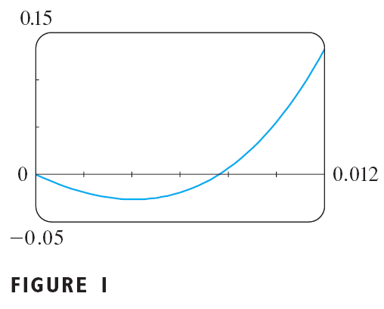
APPROXIMATE SOLUTION
We can find an approximate solution by plotting the left side of the equation.
Using a graphing device, and after experimenting with viewing rectangles, we produce the graph in Figure 1.

Slide 7
ZOOMING IN
We see that, in addition to the solution x = 0, which doesn’t interest us, there is a solution between 0.007 and 0.008
Zooming in shows that the root is approximately 0.0076

Slide 8
ZOOMING IN
If we need more accuracy, we could zoom in repeatedly.
That becomes tiresome, though.
A faster alternative is to use a numerical rootfinder on a calculator or computer algebra system.
If we do so, we find that the root, correct to nine decimal places, is 0.007628603.

Slide 9
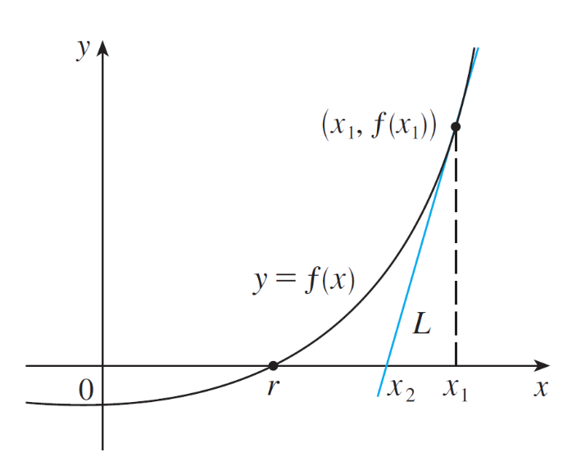
Newton’s Method
How do numerical rootfinders work? They use a variety of methods, but most of them make some use of Newton’s Method, which is also called the Newton-Raphson method. We will explain how this method works, partly to show what happens inside a calculator or computer, amd partly as an application of the idea of linear approximation.
The geometry behind Newton’s method is shown in Figure 2, where the root that we are trying to find is labeled r.
Figure 2

Slide 10
Newton’s Method
We start with a first approximation x₁, which is obtained by guessing, or from a rough sketch of the graph of f, or from a computer generated graph of f.
Consider the tangent line L to the curve y = f(x) at the point (x₁, f(x₁)) and look at the x-intercept of L, labeled x₂.

Slide 11
Newton’s Method
The idea behind Newton’s method is that the tangent line is close to the curve and so its x-intercept, x2, is close to the x-intercept of the curve (namely, the root r that we are seeking).
Because the tangent is a line, we can easily find its x-intercept.

Slide 12

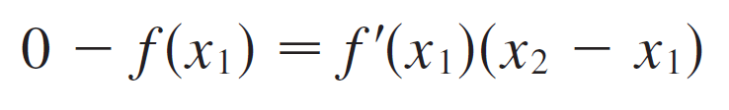
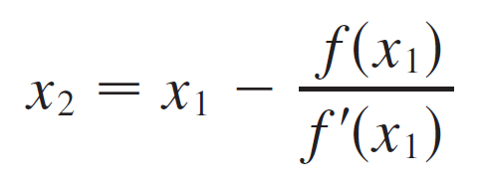
Newton’s Method
To find a formula for x₂ in terms of x₁ we use the fact that the slope of L is f ′(x₁), so its equation is
Since the x-intercept of L is x₂, we set y = 0 and obtain
If f ′(x₁) ≠ 0, we can solve this equation for x₂:
We use x₂ as a second approximation to r.

Slide 13
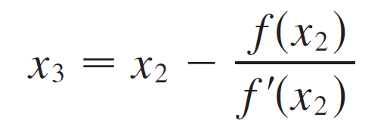
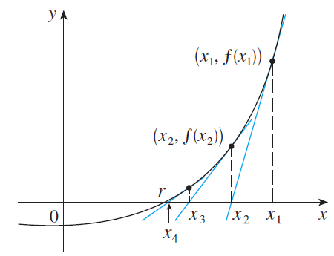
Newton’s Method
Next we repeat this procedure with x₁ replaced by x₂, using the tangent line at (x₂, f(x₂)). This gives a third approximation:
If we keep repeating this process, we obtain a sequence of approximations x₁, x₂, x₃, x₄, … as shown in Figure 3.
Figure 3

Slide 14
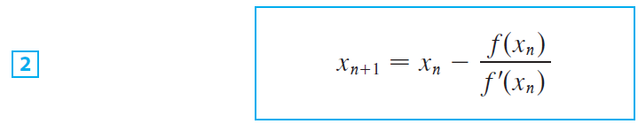
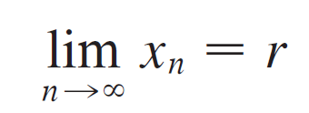
Newton’s Method
In general, if the nth approximation is x_{n} and f ′(x_{n}) ≠ 0, then the next approximation is given by
If the numbers x_{n} become closer and closer to r as n becomes large, then we say that the sequence converges to r and we write

Slide 15
CONVERGENCE
The sequence of successive approximations converges to the desired root for functions of the type illustrated in Figure 3.
However, in certain circumstances, it may not converge.

Slide 16
NON-CONVERGENCE
Consider the situation shown in Figure 4.
You can see that x₂ is a worse approximation than x₁.
This is likely to be the case when f ’(x₁) is close to 0.

Slide 17
NON-CONVERGENCE
It might even happen that an approximation falls outside the domain of f, such as x₃.
Then, Newton’s method fails.
In that case, a better initial approximation x₁ should be chosen.

Slide 18
NON-CONVERGENCE
See Exercises 23–25 for specific examples in which Newton’s method works very slowly or does not work at all.

Slide 19
Example 1
Starting with x₁ = 2, find the third approximation x₃ to the root of the equation x³ – 2x – 5 = 0.

Slide 20
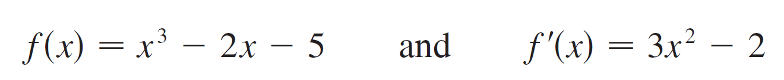
Example 1 – Solution
SOLUTION:
We apply Newton’s method with
Newton himself used this equation to illustrate his method and he chose x₁ = 2 after some experimentation because f(1) = –6, f(2) = –1, and f(3) = 16.

Slide 21



Example 1 – Solution
cont’d
Equation 2 becomes
With n = 1 we have

Slide 22

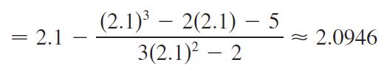
Example 1 – Solution
cont’d
Then with n = 2 we obtain
It turns out that this third approximation x₃ ≈ 2.0946 is accurate to four decimal places.

Slide 23
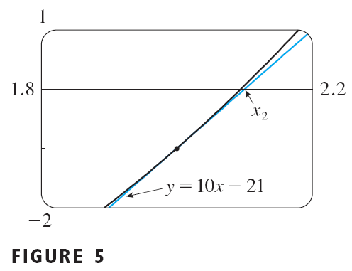
Example 1 – Solution
Figure 5 shows the geometry behind the first step in Newton’s method in the example.
As f ’(2) = 10, the tangent line to y = x³ – 2x – 5 at (2, – 1) has equation y = 10x – 21
So, its x-intercept is x₂ = 2.1.

Slide 24
Newton’s Method
Suppose that we want to achieve a given accuracy, say to eight decimal places, using Newton’s Method. How do we know when to stop? The rule of thumb that is generally used is that we can stop when successive approximations of xn and xn+1 agree to eight decimal places.
Notice that the procedure in going from n to n + 1 is the same for all values of n. (It is called an iterative process.)
This means that Newton’s method is particularly convenient for use with a programmable calculator or a computer.

Slide 25
Example 2
Use Newton’s method to find correct to eight decimal places.
SOLUTION
First, we observe that finding is equivalent to finding the positive root of the equation x⁶ – 2 = 0
So, we take f(x) = x⁶ – 2
Then, f ’(x) = 6x⁵
So, Formula 2 (Newton’s method) becomes:

Slide 26
Example 2 SOLUTION
Choosing x₁ = 1 as the initial approximation, we obtain:
As x₅ and x₆ agree to eight decimal places, we conclude that to eight decimal places.

Slide 27
Example 3
Find, correct to six decimal places, the root of the equation cos x = x.

Slide 28

Example 3 – Solution
SOLUTION:
We first rewrite the equation in standard form:
cos x – x = 0
Therefore we let f (x) = cos x – x. Then f ′(x) = –sin x – 1, so Formula 2 becomes

Slide 29
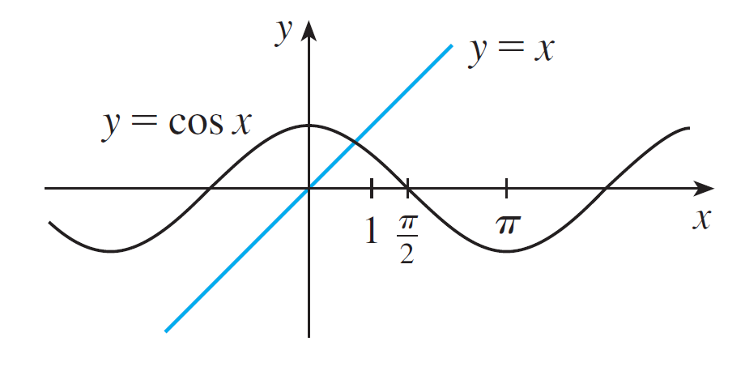
Example 3 – Solution
cont’d
In order to guess a suitable value for x₁ we sketch the graphs of y = cos x and y = x in Figure 6.
Figure 6

Slide 30
Example 3 – Solution
cont’d
It appears that they intersect at a point whose x–coordinate is somewhat less than 1, so let’s take x₁ = 1 as a convenient first approximation.
Then, remembering to put our calculator in radian mode, we get
x₂ ≈ 0.75036387
x₃ ≈ 0.73911289
x₄ ≈ 0.73908513
x₅ ≈ 0.73908513

Slide 31
Example 3 – Solution
cont’d
Since x₄ and x₅ agree to six decimal places (eight, in fact), we conclude that the root of the equation, correct to six decimal places, is 0.739085.
Instead of using the rough sketch in Figure 6 to get a starting approximation for Newton’s method in Example 3, we could have used the more accurate graph that a calculator or computer provides.

Slide 32
Example 3 – Solution
cont’d
Figure 7 suggests that we use x₁ = 0.75 as the initial approximation. Then Newton’s method gives
and so we obtain the same answer as before, but with one fewer step.

